Slide 1
Sensing Flooded Areas with Semantic Segmentation (FloodNet)
Team 8:
Kyle Fletcher
Kaden Gryphon

Slide 2
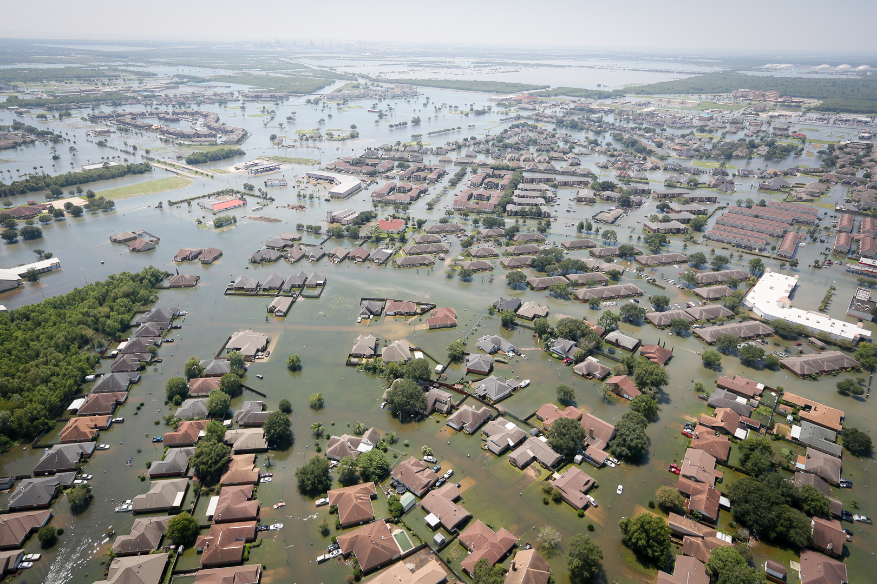
Introduction
Goal
Semantic Segmentation of FloodNet dataset
Classify each pixel of the images
Useful for determining through computer vision where flooding has occurred after a severe weather event
Uses overhead images of the landscape
Idea
Use a deep fully convolutional neural network
Similar in architecture to U-Net

Slide 3
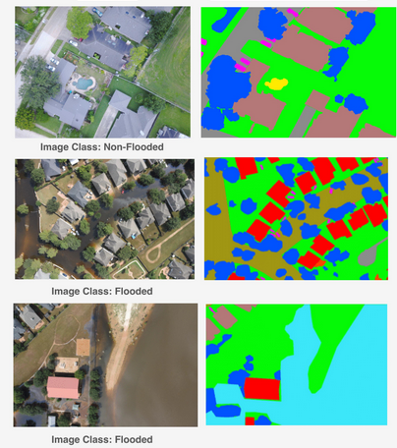
Dataset
Images where collected by camera drone after Hurricane Harvey
Images are 4000 x 3000 pixels
Per pixel classification masks
10 classes:
Background Water
Building Flooded Tree
Building Non-Flooded Vehicle
Road Flooded Pool
Road Non-Flooded Grass

Slide 4
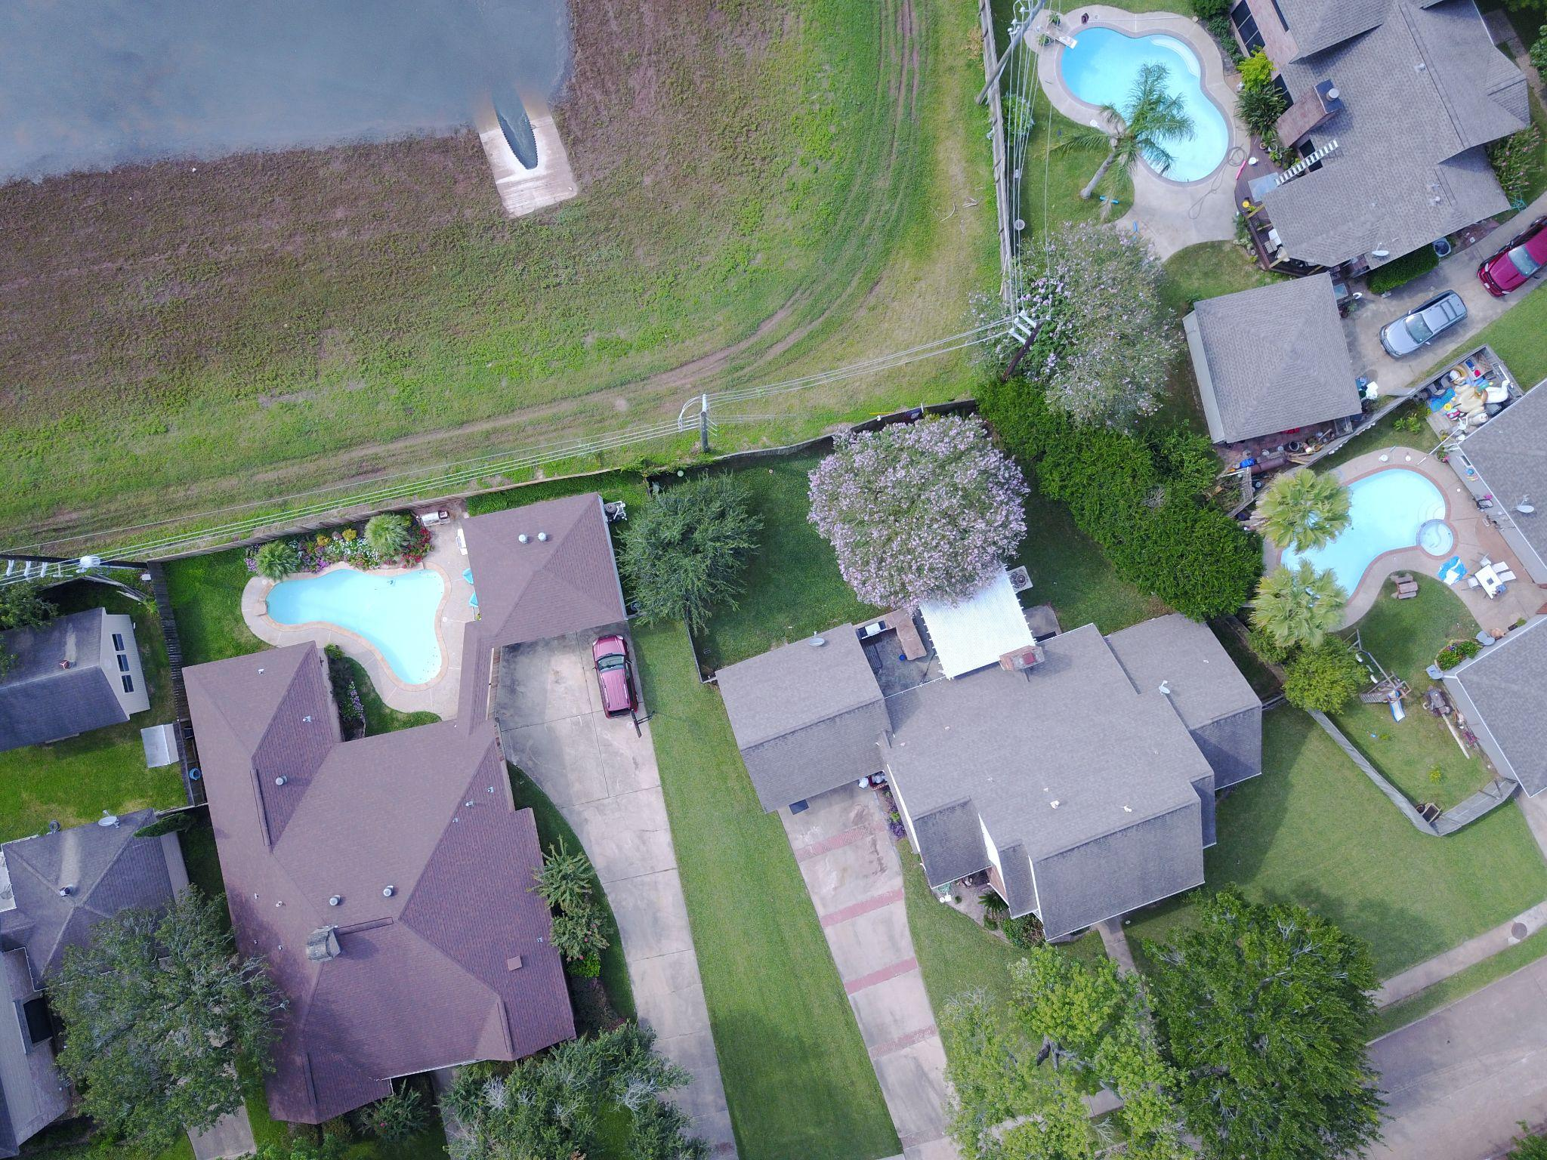
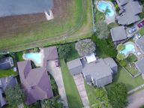
Method
Original Image
Preprocessing
4000x3000 is much too large to process in a cnn on a home computer
Images were resized to 192x144
Original Images rgb values were normalized between 0 and 1
All resized images processed in main memory and stored in pickle dumps
1445 training, 450 validation, 448 test images
Network Implemented in PyTorch
Resized Image

Slide 5
Method
Network Architecture – Similar to U-Net
32 32 32 32 10
3 32 32
192x144
192x144
64 64 64 64
32 64 64
96X72
96x72
128 128 128 128
64 128 128
48x36
48x36
3x3 Convolution + ReLU
128 256 256
256 256 256 256
2x2 Max Pooling
24x18
24x18
2x2 Deconvolution with stride 2
256 512 512
1x1 Convolution/Output
12x9
Skip Connection

Slide 6
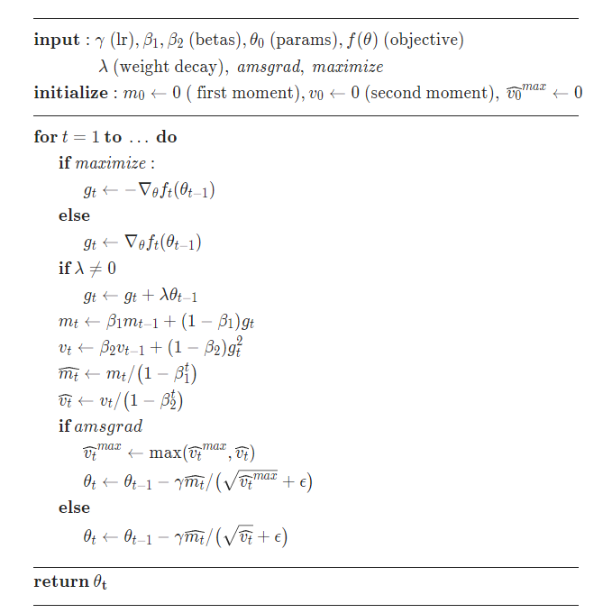
Method
ADAM Optimizer
Network Parameters
Batch Size: 64
Max number of epochs: 500
Stopping Condition: Validation Loss fails to improve for 10 epochs
Optimizer
ADAM
Initial Learning Rate: 0.001
Beta 1: 0.9
Beta 2: 0.999
No weight decay or amsgrad

Slide 7
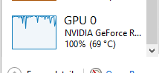
Results
Run time: Ran for 84 Epochs
Resizing and saving the transformed images: 10 mins
Training the model: 7 mins
Testing the model: 2 mins
Generating image plot: <1 min
Total: ~20 mins
Ryzen 7 3700X & RTX 3080
Training: 60% CPU, 5GB RAM, 10% GPU
Testing: 05% CPU, 22GB RAM, 50-100% GPU

Slide 8
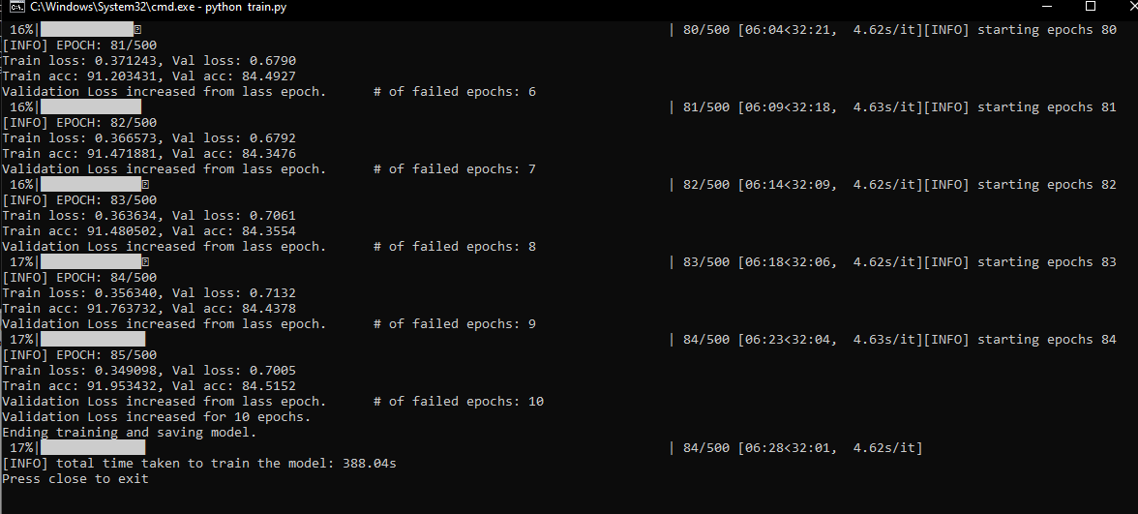
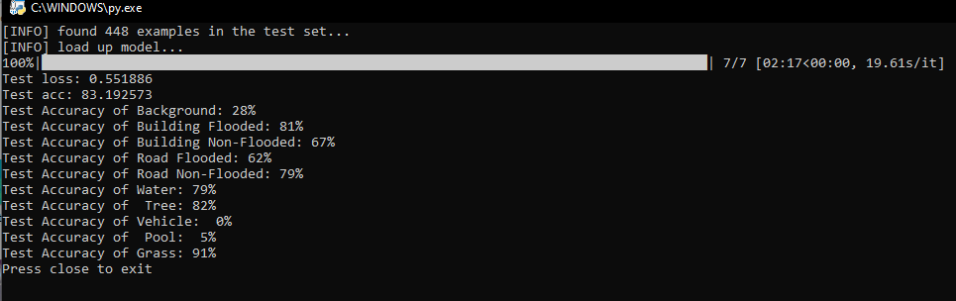
Results
Screenshots of model training and test

Slide 9
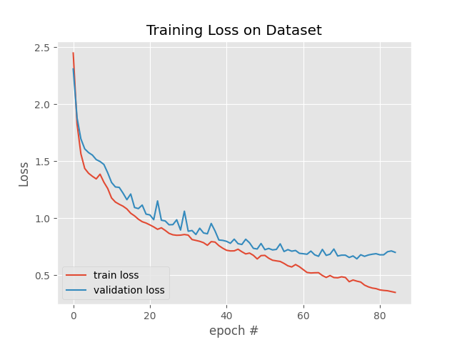
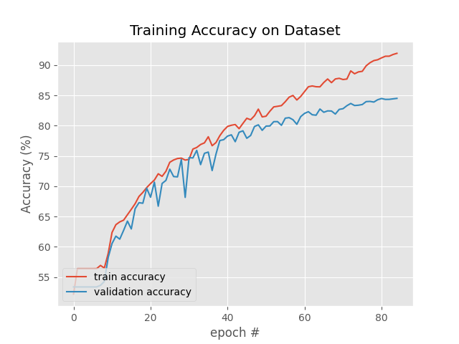
Results
Training and Validation graphs

Slide 10
Results
Testing results
Total Loss | 0.551
Total Accuracy | 83.19%
Accuracy of Background | 28%
Accuracy of Building Flooded | 81%
Accuracy of Building Non-Flooded | 67%
Accuracy of Road Flooded | 62%
Accuracy of Road Non-Flooded | 79%
Accuracy of Water | 79%
Accuracy of Tree | 82%
Accuracy of Vehicle | 0%
Accuracy of Pool | 5%
Accuracy of Grass | 91%

Slide 11
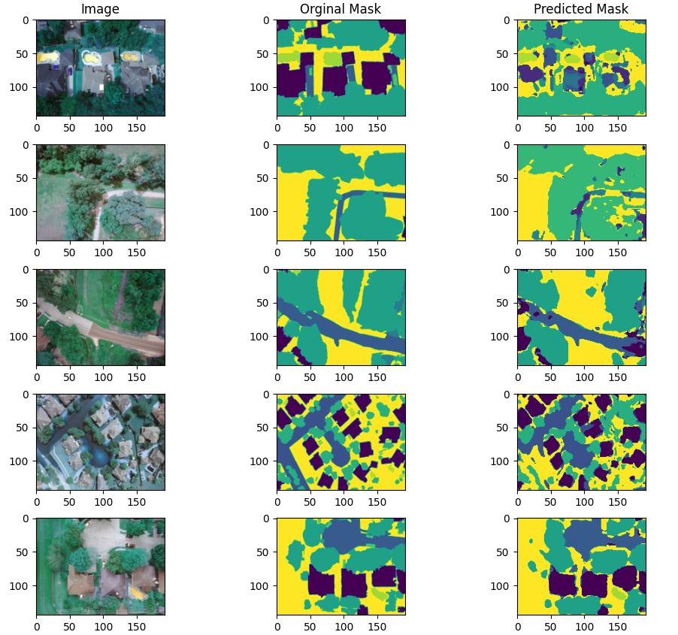
Results

Slide 12
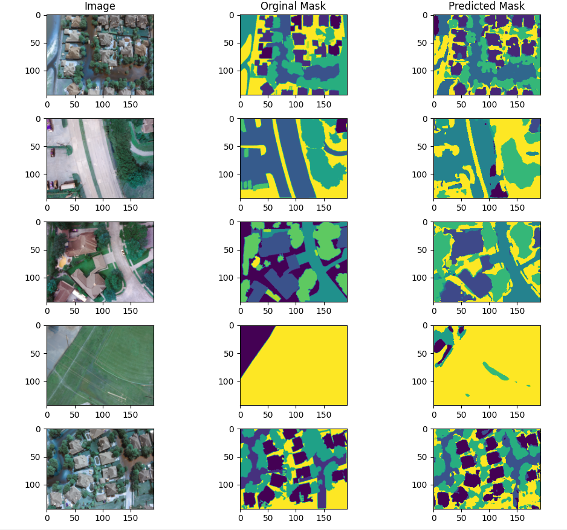
Results

Slide 13
Conclusion
Somewhat successful at segmenting FloodNet Images
Images had to be resized to be much lower resolution than originally
Fully convolutional network with similar architecture to U-Net
Equal amounts of pooling and upsampling + convolutional layers and skip connections
Training done using ADAM and stopped before major overfitting
Difficulty classifying smaller objects like cars and pools
Good at classifying large areas

Slide 14
Link to Dataset
https://github.com/BinaLab/FloodNet-Supervised_v1.0?tab=readme-ov-file

